Slide 1

Server and Systems Administration Module Code : CSC3504
Simeon NDAYAMBAJE
Server and Systems Administration , CSC3504
1

Slide 2
Chapter 1
Introduction

Slide 3
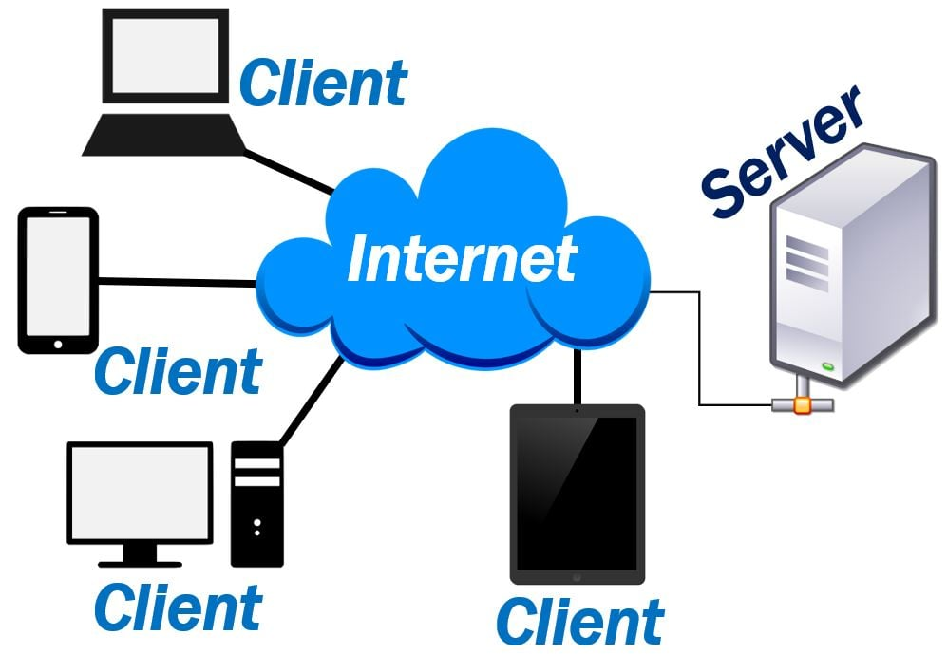
What is server?
A server is a computer, a device or a program that is dedicated to managing network resources.
A server is a computer used in a network and which provides a service to a client.
Servers usually have more processing power, memory and storage than client computers.

Slide 4
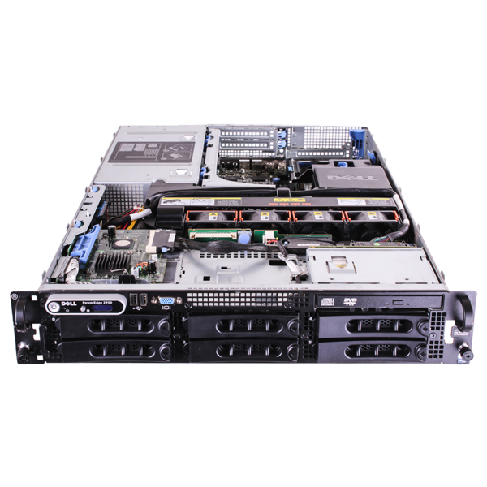
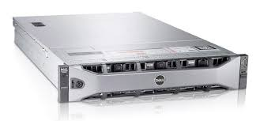
How dedicated server(Hardware) look like?

Slide 5
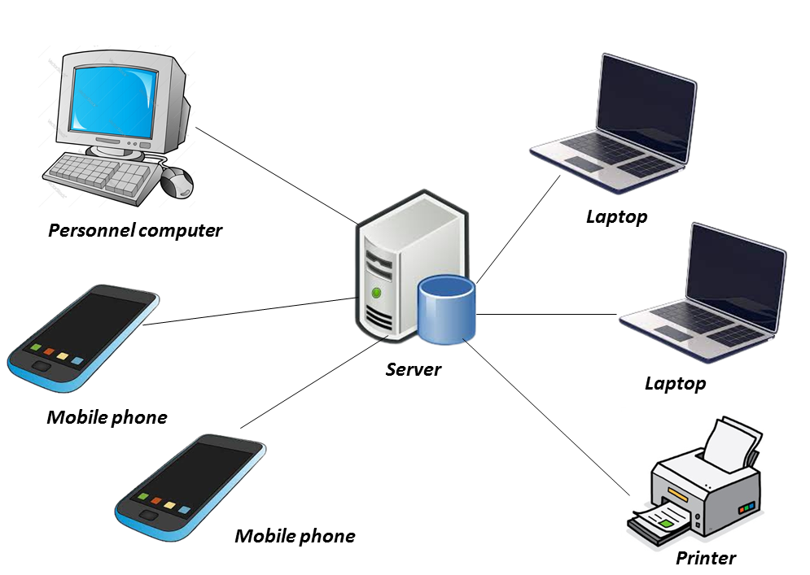
What is a Network Operating System?
A Network Operating System (NOS) is a particular type of operating system that includes necessary software and protocols to enable communication with other independent computers over a network.

Slide 6
Network Operating System
A NOS coordinates the activities of multiple computers across a network ( eg: PCs, printers, file servers and databases connected to a local network).
Modern examples of network operating systems include
Microsoft Windows Server,
Linux distributions configured for network services (such as Ubuntu Server or CentOS),
macOS Server.

Slide 7
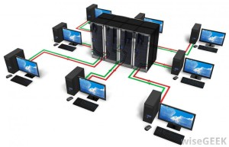
What is System administration?
System administration refers to the management of one or more hardware and software systems.

Slide 8
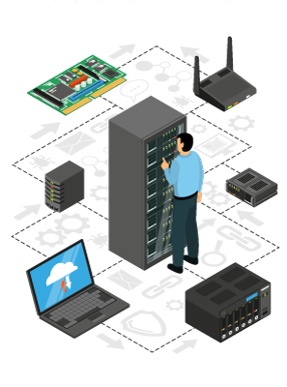
Who perform System Administration?
Done by a system administrator.
He/she is responsible of:
Monitors system health,
Allocates system resources ,
performs backups,
Provides user access,
Manages user accounts,
Monitors system security and
Performs many other functions

Slide 9
Architectural model
How Network and computing Devices communicate?
Network and computing Devices can communicate by using one of the bellow Architecture model:
Peer-to-peer (P2P)
Client-Server

Slide 10
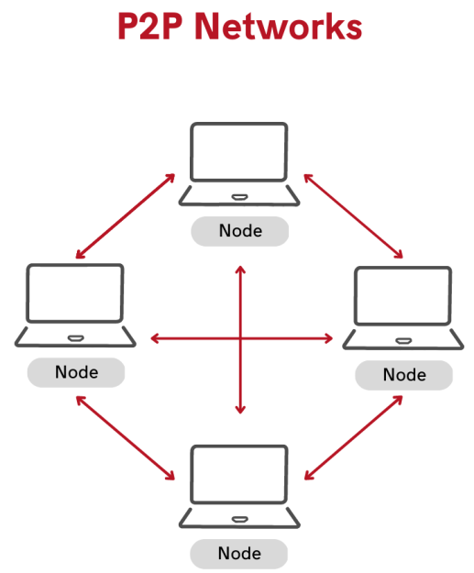
Peer-to-peer (P2P): each device in this network called peers, interact directly with each other without needing a central authority or server.
In a P2P network, each participant acts as both a client and a server, enabling them to share resources and services directly with other peers

Slide 11
P2P Network architect
In P2P Network architect:
P2P use a distributed architecture.
The computers or devices that are part of a peer-to-peer network are called peers.
Files can be shared directly, There are no privileged peers, and there is no central administrator device

Slide 12
Advantages of a peer-to-peer network
It is less expensive, there not require to use the dedicated server computer. Any computer on the network can function as both a network server and a user workstation.
It is very easy to install or setup user needs means that you can spend less time and effort in the configuration and implementation.
Each user has to manage its own PC so there is no need for a network manager.
There is less traffic than another network.
The loss of a single node does not bring down the entire network

Slide 13
Disadvantages of peer to peer network
A computer can be accessed anytime.
More vulnerable to remote attacks
Network security has to be applied to each computer separately.
Backup has to be performed on each computer separately.
To manage and control the access is very complex
Users have to use separate passwords on each computer in the network.

Slide 14
Applications of P2P Network
Below are some of the common uses of P2P network:
File sharing: Using this type of network there is no need for intermediate servers to transfer the file.
Block chain: The P2P architecture is based on the concept of decentralization.
Direct messaging: P2P network provides a secure, quick, and efficient way to communicate.
Collaboration: The easy file sharing also helps to build collaboration among other peers in the network.
File sharing networks: Peer-to-Peer technologies simplify file sharing
IP Telephony: Skype is one good example of a P2P application in VoIP.

Slide 15
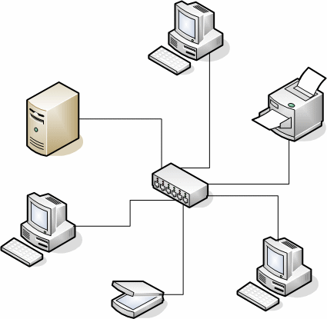
Client-Server Network
A Computer networking model where one or more powerful computers (servers) provide network services and all other computers (clients) access those services to perform user's tasks.

Slide 16
Client-Server Description
A server is a specialized computer that controls the network resources and provides services (files, directories, applications & shared devices like printer) to other computers in the network.
A server performs all the major operations like security and network management.
If any of the clients wants to access these services, it first seeks permission from the server by sending a request.
When a client requests a connection with a server, the server has the option of accepting or rejecting the request.

Slide 17
Advantages of Client-server networks:
Centralized: Centralized back-up is possible in client-server networks.
Single repository: Centralized system with all data in a single place
Security: All the shared resources are centrally administered.
Performance: This increases the performance of the overall system.
Scalability: the new element can be added at any time.
Simplify Update: System as soon as new version of OS and application software comes out

Slide 18
Disadvantages of Client-Server network:
Traffic Congestion : When a large number of clients send requests to the same server may cause the problem of Traffic congestion.
Fail of Server: when the server is down, it will affect entire system.
Specialized servers: It requires specialized servers(Hardware) with large memory and secondary storage. This leads to increase in the cost.
Dedicated network administrator: Qualified person is needed to handle administration.

Slide 19
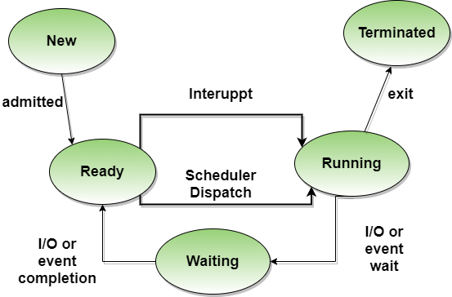
Network operating system Process Life Cycle

Slide 20
States of machines or Process Life Cycle
Start: This is the initial state when a process is first started/created.
Ready: The process is waiting to be assigned to a processor.
Running: processor executes its instructions.
Waiting: Process moves into the waiting state if it needs to wait for a resource, such as waiting for user input, or waiting for a file to become available.
Terminated or Exit: the process is moved to the terminated state where it waits to be removed from main memory.

Slide 21
Thank you

